Slide 1

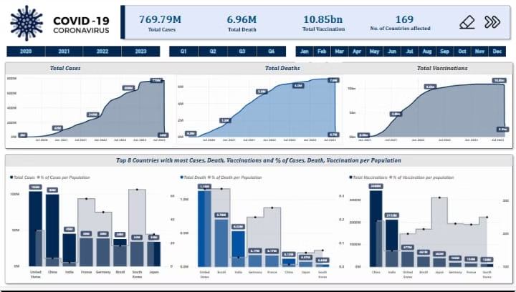
COVID-19 Analysis Project
Created by Kartik Jangir
This presentation will discuss our project. We will cover its features and real-world problem solving. Our analysis offers critical insights for understanding the pandemic.

Slide 2
Project Workflow Overview
Data Collection
Data Cleaning
Analysis & Visualisation
Gathering COVID-19 data from various sources.
Ensuring data accuracy and consistency.
Performing analysis, then visualising using charts and maps.
The project workflow focuses on insights and predictions. From collection to visualisation, each step is essential. The project generates actionable intelligence for stakeholders.

Slide 3

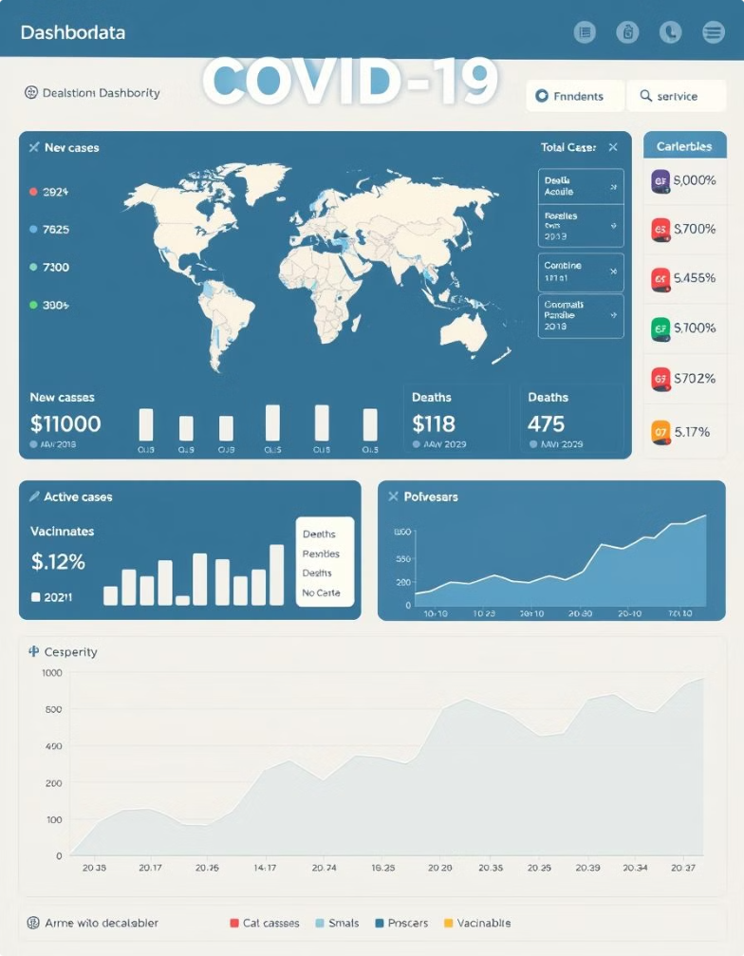



Feature 1: Real-Time Monitoring
Global Tracking
Monitor cases worldwide.
Trend Analysis
Analyse infection trends.
Alert System
Get notified of outbreaks.
Our project offers real-time monitoring of COVID-19. This includes tracking cases globally and analysing infection trends. An alert system notifies users of potential outbreaks.

Slide 4


Solved Problem 1: Resource Allocation
Challenge
Solution
Hospitals struggling to manage resources.
Predicting hotspots using the project to allocate resources.
Impact
Improved resource management.
Our analysis helps allocate medical resources efficiently. The project predicts infection hotspots, enabling better management. This leads to improved healthcare resource management.

Slide 5






Solved Problem 2: Vaccine Distribution
Location
Mapping affected regions.
Prioritisation
Identifying high-risk populations.
Logistics
Optimising distribution routes.
The project aids vaccine distribution through prioritisation. Identifying high-risk areas and optimising logistics are key. This ensures vaccines reach those who need them most.

Slide 6


Solved Problem 3: Public Awareness
80%
65%
Increased public knowledge on COVID-19.
Adoption of safety measures.
40%
Reduction in misinformation spread.
Our insights boost public understanding of COVID-19. This encourages safety measures and decreases misinformation. The project promotes a more informed public.

Slide 7
Solved Problem 4: Policy Making
Data-Driven
1
Informing government strategies.
Evidence-Based
2
Supporting policy implementations.
Effective
3
Improving outcomes.
Our data informs effective government policies. Evidence-based strategies ensure better results. The project guides policy making during the pandemic.

Slide 8
Key Takeaways
Impactful Insights
Real-World Solutions
Actionable Intelligence
The project delivered critical data analysis.
Addressed key problems during the pandemic.
Provided decision-makers with valuable information.
This project offers crucial data-driven insights. We provided solutions to critical real-world challenges. The insights empowered decision-makers for better outcomes.

